Slide 1
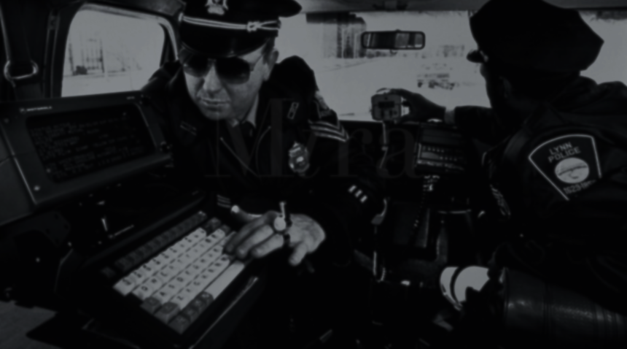
The Uses of computers
in the Police
by Alexander Red’ko
Notes:
My report is called “The Uses of Computers in the Police”. I’ll be speaking for two minutes.

Slide 2
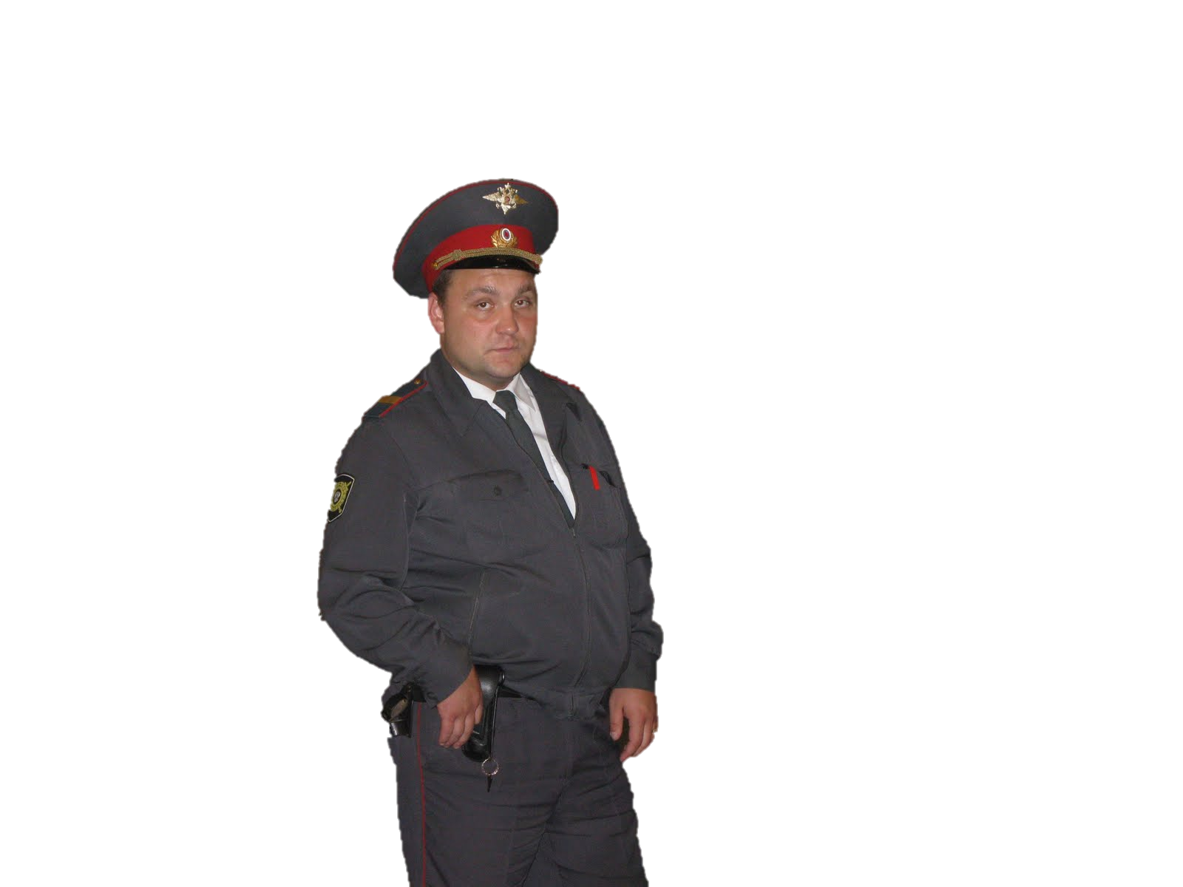
There lived a
POLICEMAN
Notes:
Once upon the time in a very small country town, at a considerable distance from Moscow, there lived a Policeman.
One day that man decided to make a tour of the foreign police departments.

Slide 3
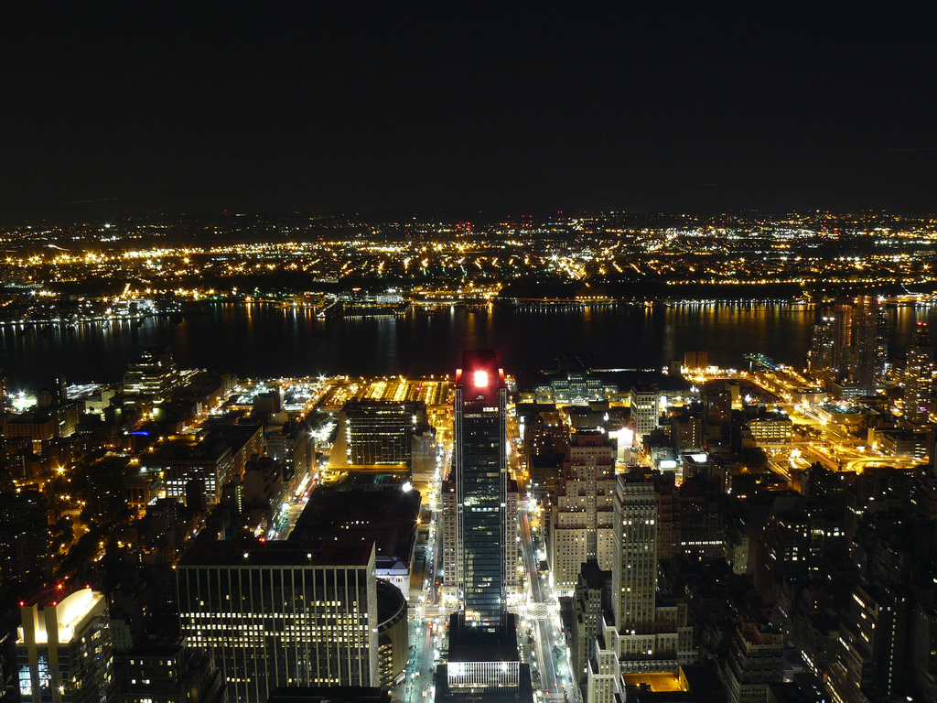
He visited the NEW YORK
Notes:
He was determined to go to the New York police departments.

Slide 4
what
did he see there?

Slide 5
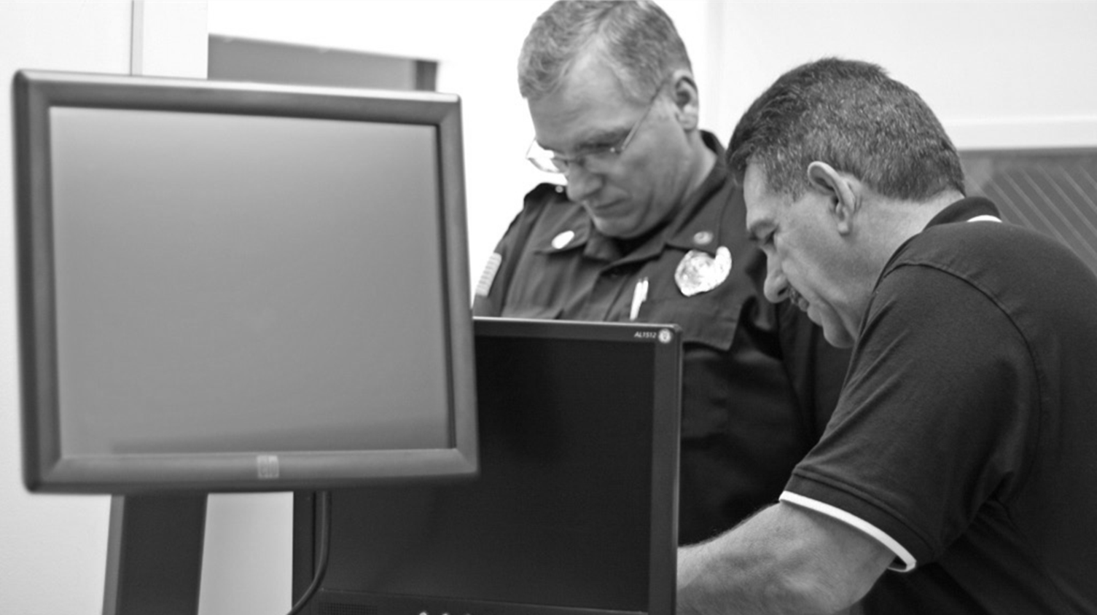
Computers
everywhere
Notes:
The policeman was shocked after he had arrived to the New York police department #1.
Computers are used everywhere in the police of the USA. Computers have changed the way people communicate and work. In this police department, computerized information systems have become an integral part of the war on crime.

Slide 6
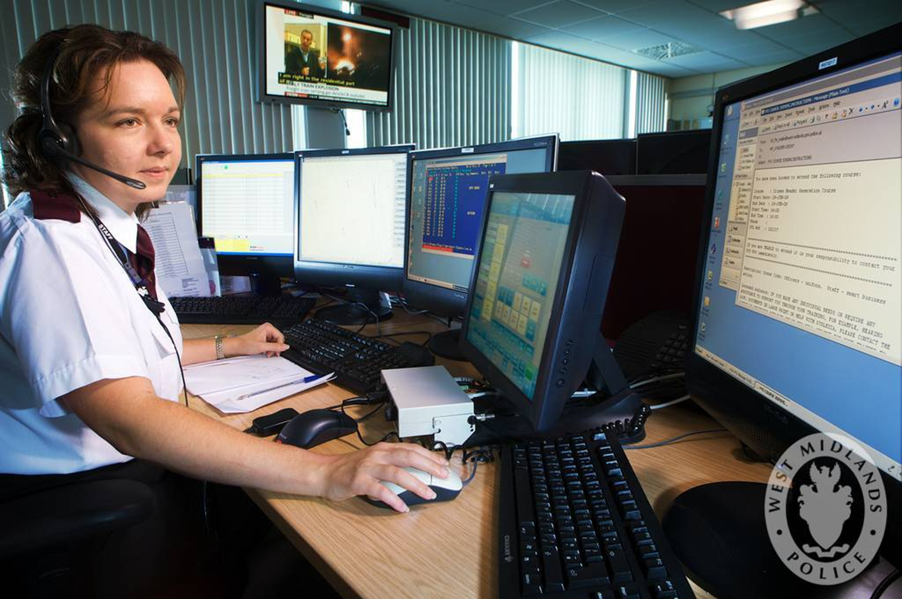

CommUNication
Notes:
Computers help to communication within police departments. Emails, website updates, blogs and other forms of digital communication have become some of the primary forms of communication in police department.

Slide 7
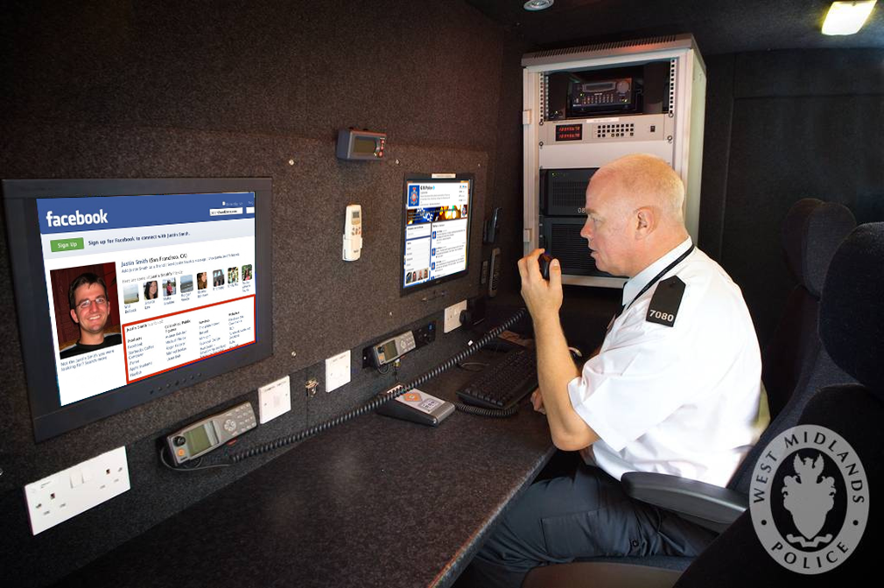


Reseach work
Notes:
Police detectives use Internet resources to quickly find out facts and information regarding specific cases. Police officers closely monitor suspects online, something that some police officers have taken advantage of using social media sites like Facebook and Twitter.

Slide 8
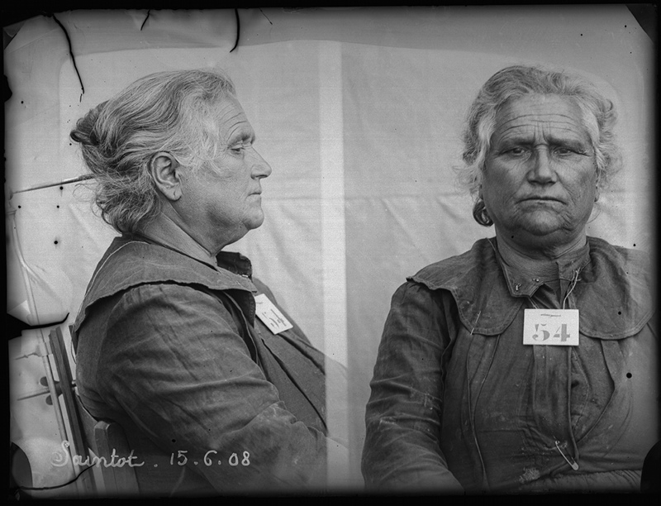

Records
and
Databases
Police record of a woman, named Saintot. Alphonse Bertillon method. 1908, june 15
Notes:
Police officers store records and reports in online databases, they also use computers and hard drives to store thousands of images, reports and videos.

Slide 9
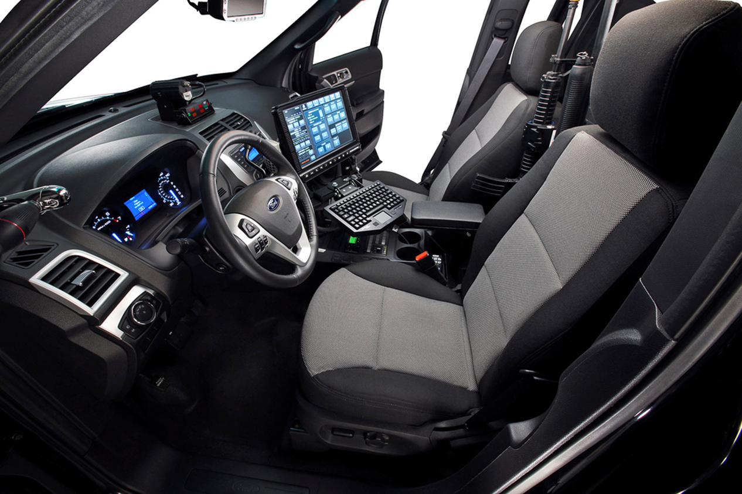

Police vehicles
Notes:
Computers are also used in police vehicles. Computers make it possible for mobile police units to look up information, run license plates and find locations while on the road.

Slide 10
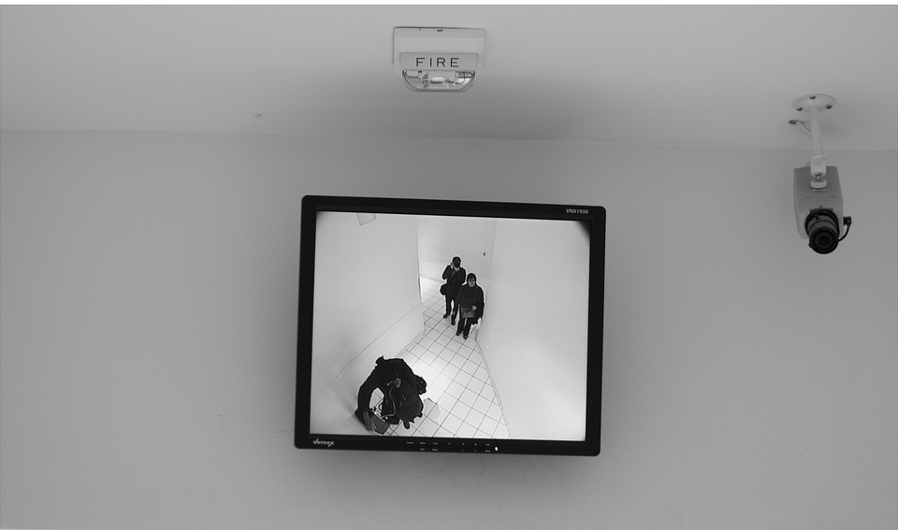

Security
Notes:
Additionally, computer systems are used in conjunction with video cameras to provide internal surveillance and to ensure the safety of prisoners and officers.

Slide 11
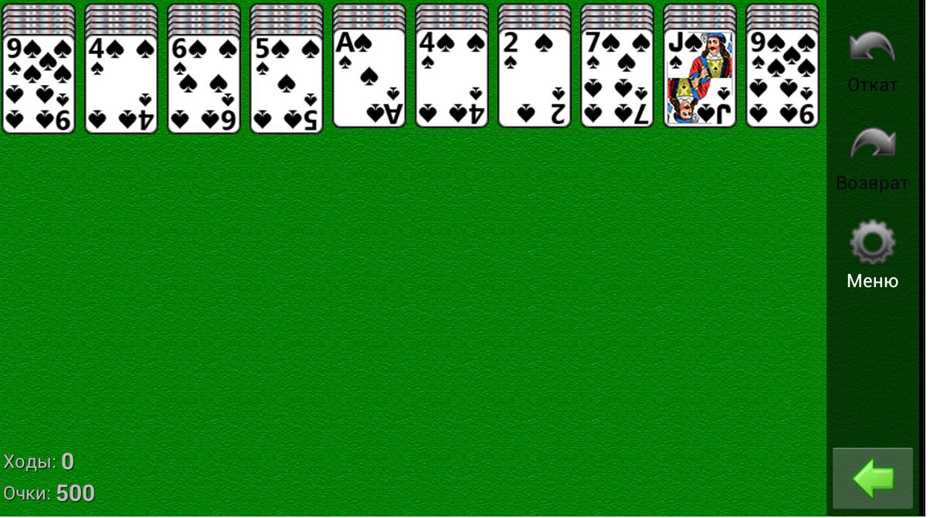
Computer is
not for “Cosynka”
Notes:
Russian Policeman come back to the home. There he said to other officers that a computer is destined not only for game “Kosynka”.

Slide 12
Reseach
Records
CommUNicatE
vehicles
Security
Notes:
It can be used for communication, research and detective work, to keep records and online databases, to provide security, they may be build-in into police cars.

Slide 13
The END

Slide 14
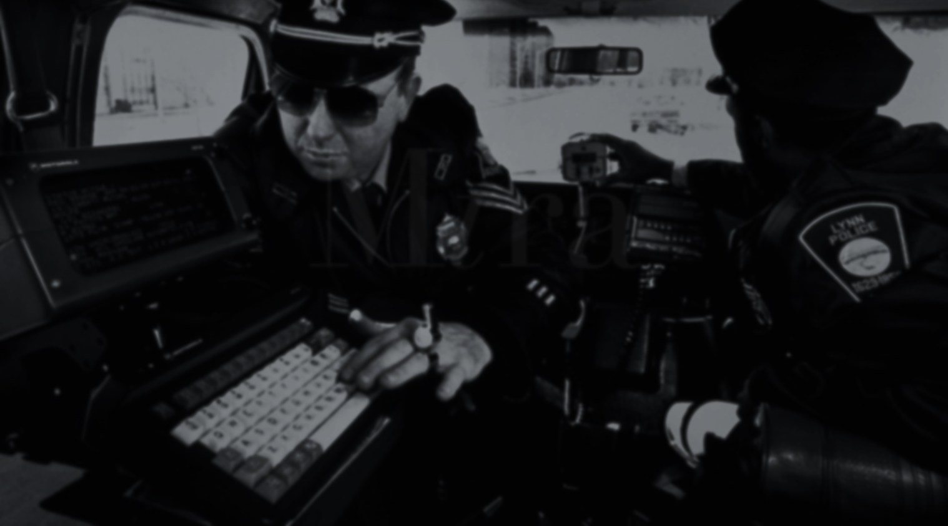

Made using PowerPoint
CREDITS:
WEBSITES:
ehow.com noteandpoint.com
flickr.com slideshare.net
10.2012

